Slide 1
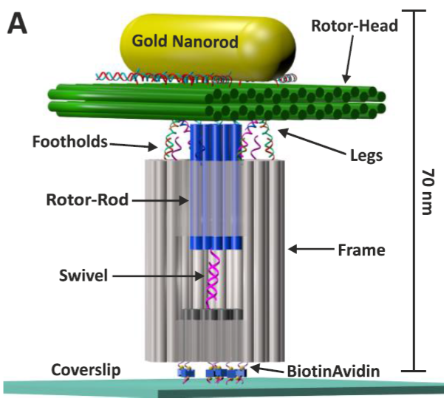
Develop of a robust rotary motor that is free from the problem of processivity
Hadas Volkov
21/11/16
Illustration of the rotary motor immobilized on glass coverslip. Eyal Nir

Slide 2
Analyze of monomer Origami using TEM
TEM Protocol (Used by Miran)
For the imaging using Transmission Electron Microscopy (TEM) the origami samples were deposited on a ultrathin carbon coated grid (400 meshes, Ted Pella), which was negative glow discharge using an Emitch K100X machine for 60sec and treated with 1M MgCl₂ for 6 minutes. 5μL of the sample was deposited for 5 minutes and excess sample was wicked from the grid using filter paper. The grid was treated with a drop of 1% uranyl formate solution and excess solution was wicked away using filter paper. The grid was treated again with a second drop of uranyl formate solution for 30-60 seconds, and the excess solution was removed using filter paper. To evaporate any additional solution residues, the grid was kept at room temperature for 30 minutes. TEM images were taken by using a Tecnai-12 transmission electron microscope (FEI), operated at 120 kV in the bright field mode

Slide 3
TEM Sample preparation protocol Multilayer DNA Origami Packed on Hexagonal and Hybrid Lattices, W.M. Shih, JACS, 2011
TEM studies. The TEM sample was prepared by dropping 3.5µL of sample solution on a
carbon-coated grid (400 mesh, Ted pella). Before depositing the sample, the grids were
negatively glow discharged for 45 seconds. After 2 minutes, the sample was wicked from
the grid by touching its edge with a piece of filter paper. Then the grid was touched with
a drop of 2 % uranyl formate solution and excess solution was wicked away with a filter
paper. Again the grid was touched with a second drop of uranyl formate solution for 20
seconds, and the excess solution was removed with a filter paper. TEM studies were
conducted using a JEOL JEM-1400 transmission electron microscope, operated at 80 kV
on bright field mode.

Slide 4
TEM Sample preparation protocol DNA Origami Gatekeepers for Solid-State Nanopores, H. Dietz, 2012
Particles were adsorbed on glow-discharged formvar-supported carbon-coated Cu400 TEM grids and
stained using a 2% aqueous uranyl formate solution containing 25 mM NaOH. Imaging was performed
using a Philipps CM100 electron microscopy operated at 100 kV. Images were acquired using a AMT
4x4 Megapixel CCD camera. Micrograph scale bars were calibrated using 2D catalase crystal lattice
constants as length reference. Imaging was performed at 28500x magnification.

Slide 5
Analyze of monomer Origami using TEM
Two samples of reg. origami in different annealing procedure were measured in TEM
12 hr annealing up to 65C (1x TAE 12 Mg)
10 min up to 53C (1x TAE 12 Mg)
Each sample is 4nM concertation made from 5uM Pre. stock and 400nM scaffold stock
Each sample was prepared according to Miran’s protocol with the following deviations:
Negative discharge: 45 sec
Uranyl acetate (2.5 uL drop) 1% and 2% (second drop 45 sec), instead of Uranyl formate 1%.

Slide 6
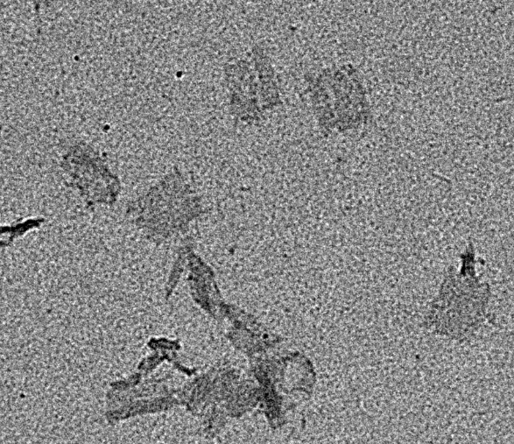
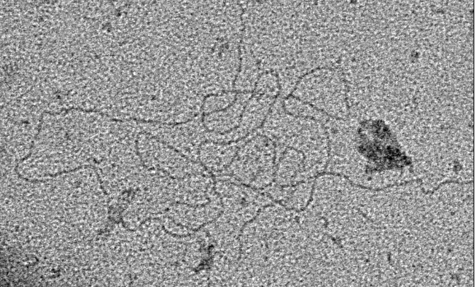
REG Origami 1X TAE 12Mg ANN 53C 1% UA
Unfolded scaffold
Origami, mostly distorted, dimension ~50 X ~70 nm

Slide 7
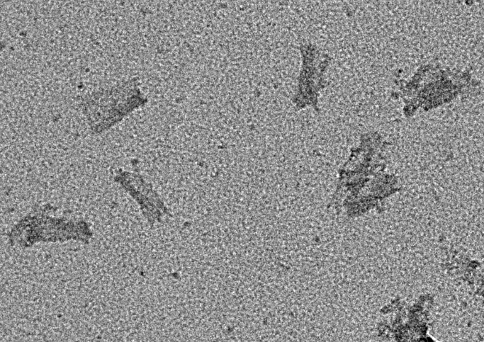
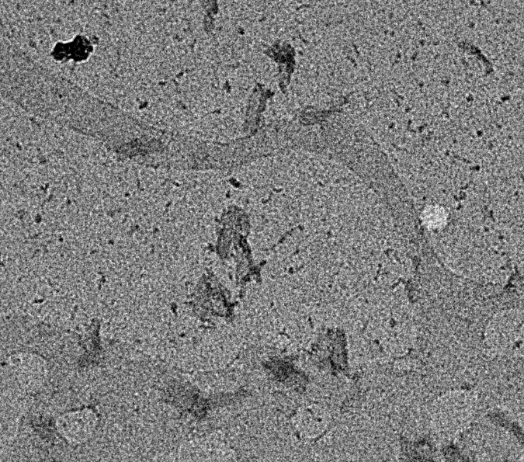
REG Origami 1X TAE 12Mg ANN 53C 2% UA
Origami, staining of origami and background, lower resolution

Slide 8
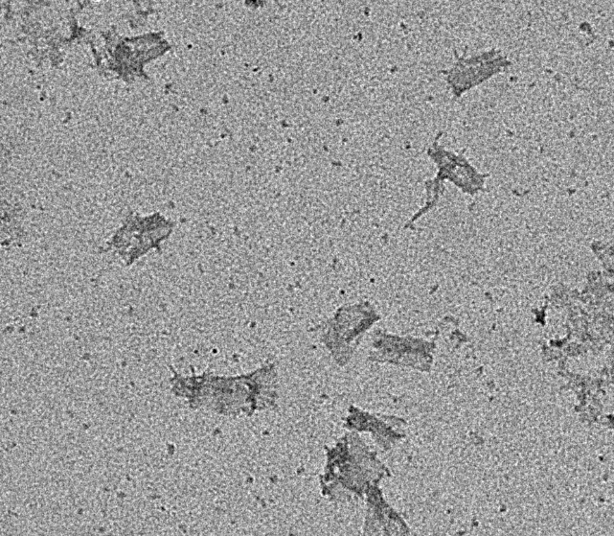
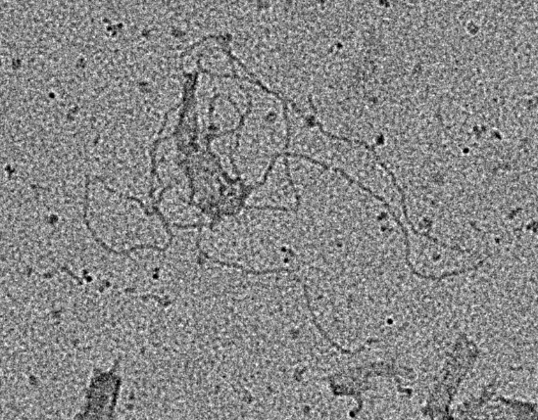
REG Origami 1X TAE 12Mg ANN 65C 1% UA
Origami – Scaffold
Origami, mostly defected

Slide 9
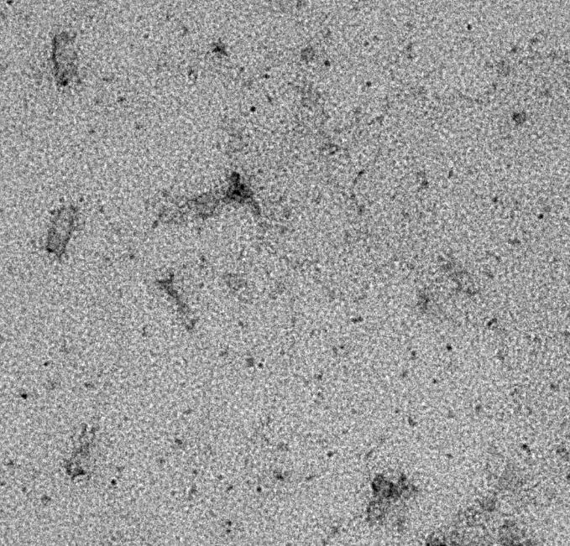
REG Origami 1X TAE 12Mg ANN 65C 2% UA
Origami, staining of
background

Slide 10
Conclusion
There’s no visible difference between annealing procedure when viewed under TEM
2% UA stains the background and origami, lowering contrast and resolution
Most of the origami is folded upon himself making it difficult to view actual size when spread
Contamination is visible in all samples

Slide 11
Further experiments
Imaging zig zag origami and tube origami
Imaging without UA
Consulting with Dietz group about protocol procedure to maximize resolution
Construction of rotary motor parts and viewing under TEM

